Slide 1
CLASSIFICATION – KERNEL SVM
Nghia Tran 7th June

Slide 2
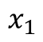
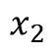
Support vector machine (SVM)
Maximum Margin
Positive Hyperplane
$$x_{2}$$
Maximum Margin Hyperplane
Maximum Margin Classifier
Support Vectors
Positive Hyperplane
$$x_{1}$$
Notes:
Trong toán học cao cấp, một véc-tơ là một phần tử trong một không gian vectơ, được xác định bởi ba yếu tố: điểm đầu (hay điểm gốc), hướng (gồm phương và chiều) và độ lớn (hay độ dài).

Slide 3
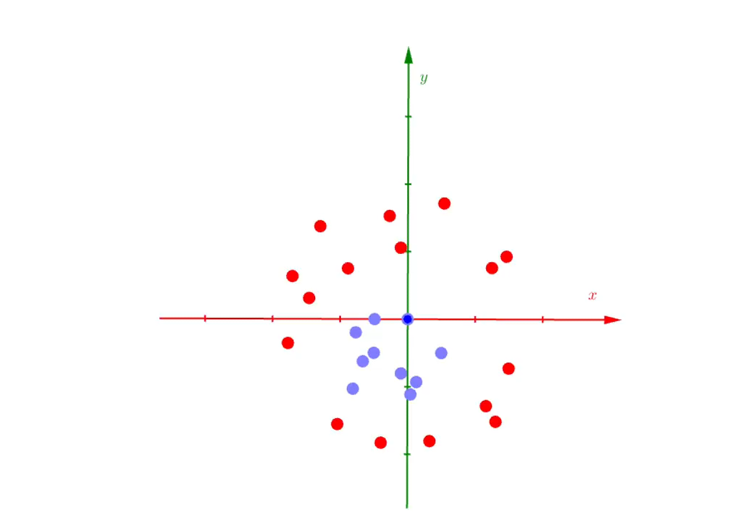
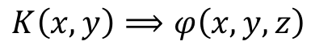
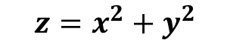
Kernel SVM: Visual
Add more dimension:
$$z=x^{2}+y^{2}$$
$$K\left(x,y\right)⟹φ\left(x,y,z\right)$$

Slide 4
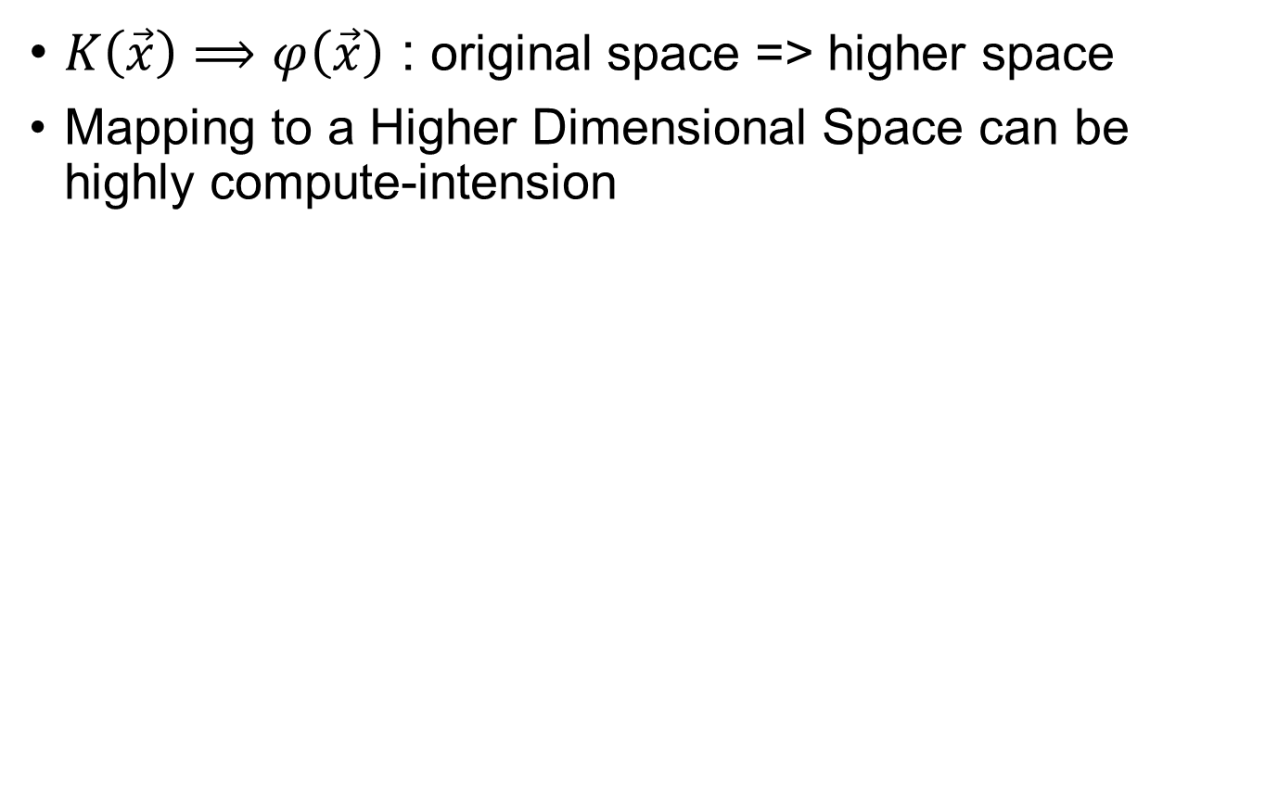
Kernel SVM: Conclusions
$K\left(\vec{x}\right)⟹φ\left(\vec{x}\right)$ : original space => higher space
Mapping to a Higher Dimensional Space can be highly compute-intension
Kernel functions

Slide 5
Kernel functions
Linear
Radial basis function (RBF)
Polynomial
Sigmoid

Slide 6
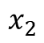
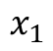
Non-linear separable data
$$x_{2}$$
$$x_{1}$$

Slide 7
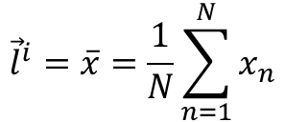
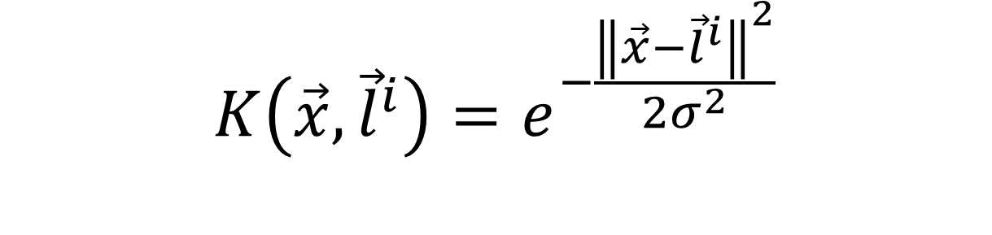
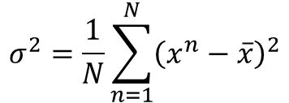
The Gaussian RBF Kernel
$${\vec{l}}^{i}=\overline{x}=\frac{1}{N}\sum_{n=1}^{N}{x_{n}}$$
expectation
$$K\left(\vec{x},{\vec{l}}^{i}\right)=e^{−\frac{{\left\|\vec{x}−{\vec{l}}^{i}\right\|}^{2}}{2σ^{2}}}$$
$$σ^{2}=\frac{1}{N}\sum_{n=1}^{N}{{\left(x^{n}−\overline{x}\right)}^{2}}$$
variance

Slide 8
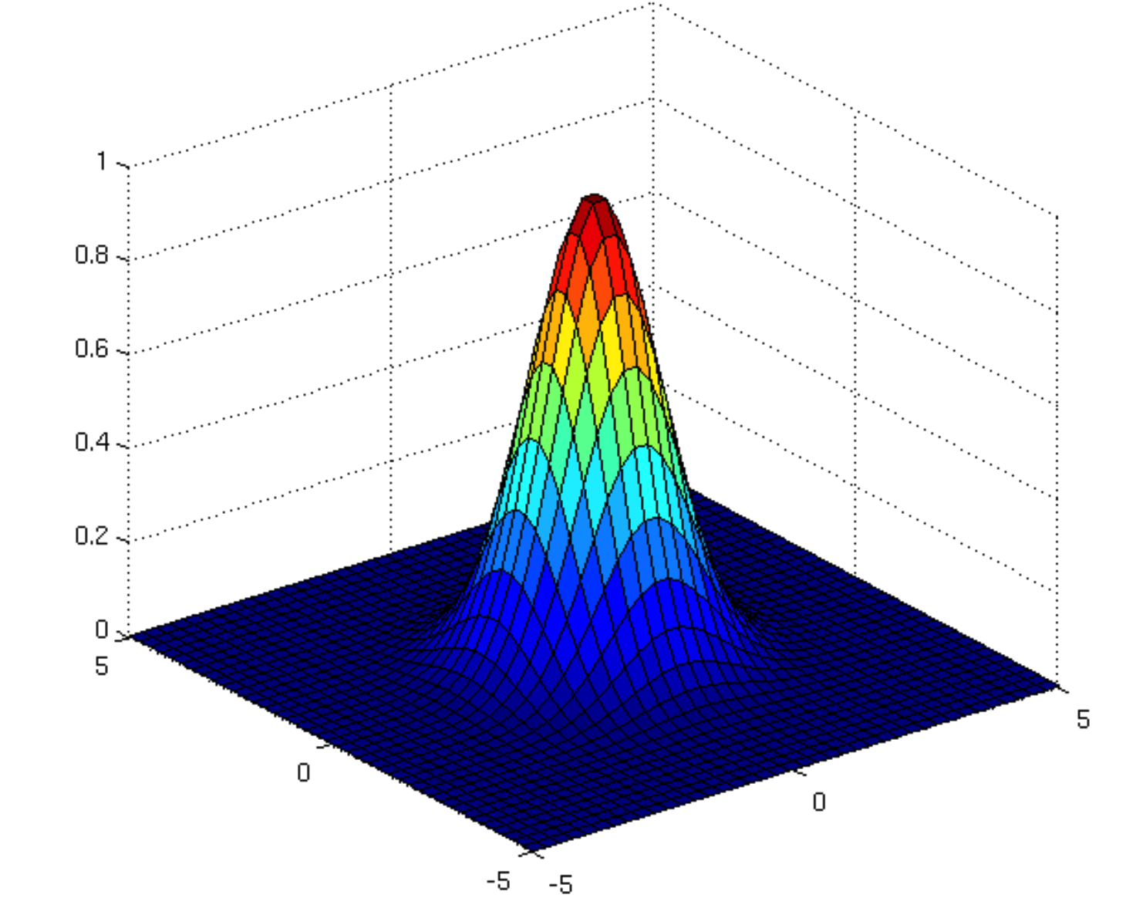
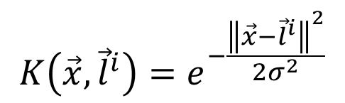
The Gaussian RBF Kernel
$$K\left(\vec{x},{\vec{l}}^{i}\right)=e^{−\frac{{\left\|\vec{x}−{\vec{l}}^{i}\right\|}^{2}}{2σ^{2}}}$$
Image source: http://www.cs.toronto.edu/~duvenaud/cookbook/index.html

Slide 9
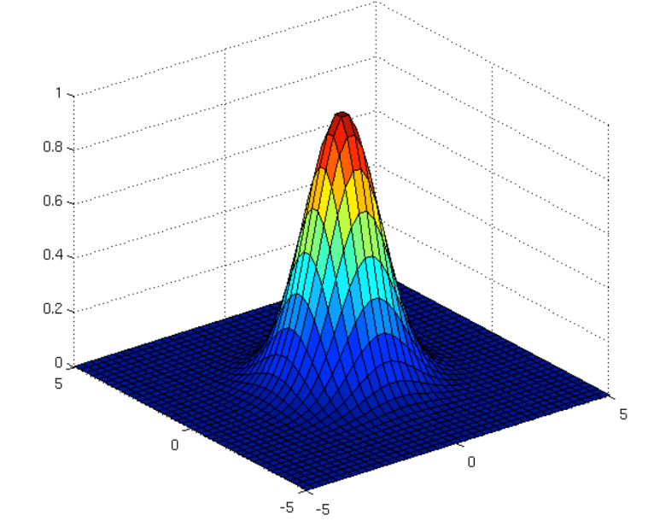
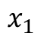
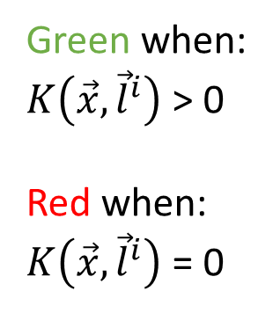
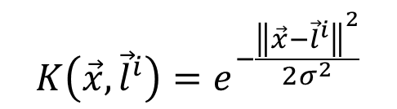
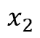
The Gaussian RBF Kernel
2D space
$$x_{2}$$
$$K\left(\vec{x},{\vec{l}}^{i}\right)=e^{−\frac{{\left\|\vec{x}−{\vec{l}}^{i}\right\|}^{2}}{2σ^{2}}}$$
landmark
Green when:
$K\left(\vec{x},{\vec{l}}^{i}\right)$ > 0
Red when:
$K\left(\vec{x},{\vec{l}}^{i}\right)$ = 0
$$x_{1}$$

Slide 10
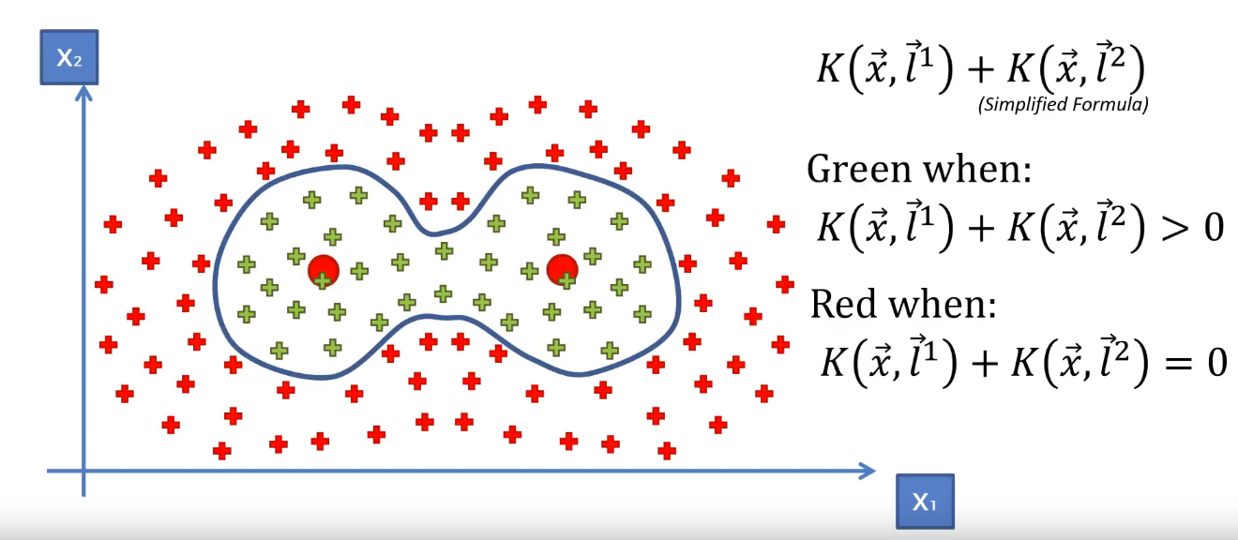
The Gaussian RBF Kernel

Slide 11
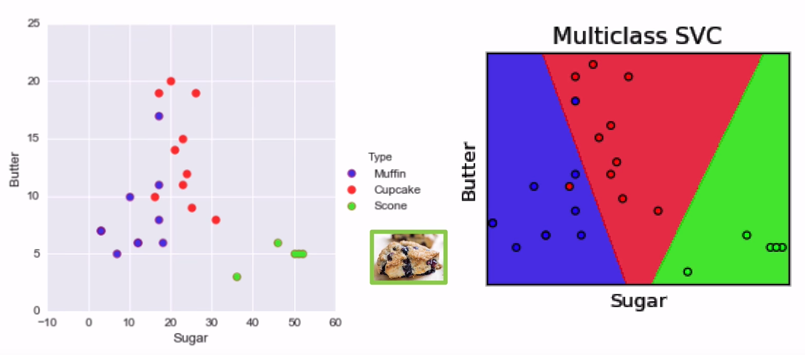
Multiple Classes: Visual

Slide 12
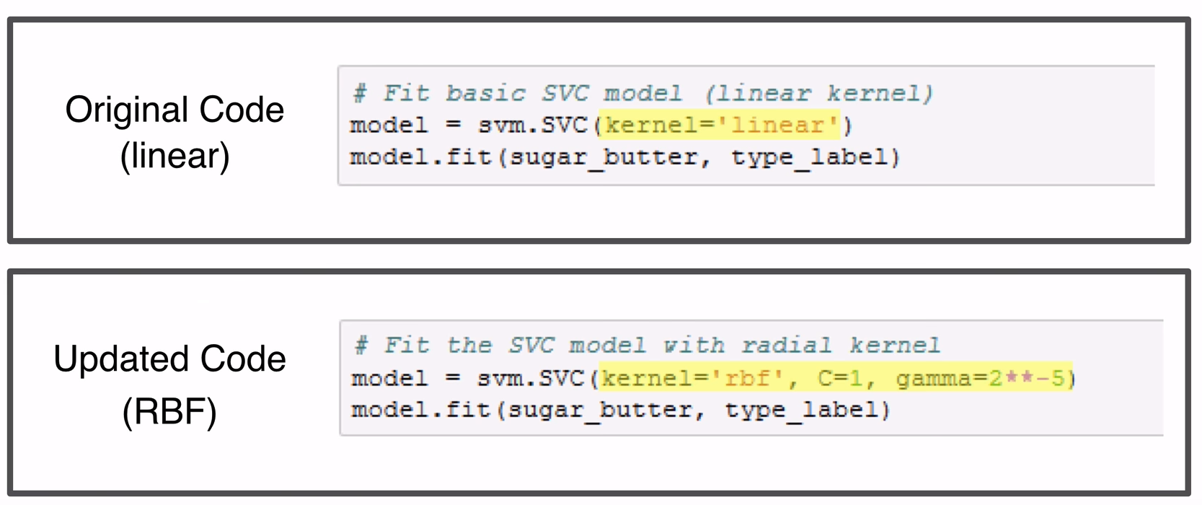
Kernel Trick: Code

Slide 13
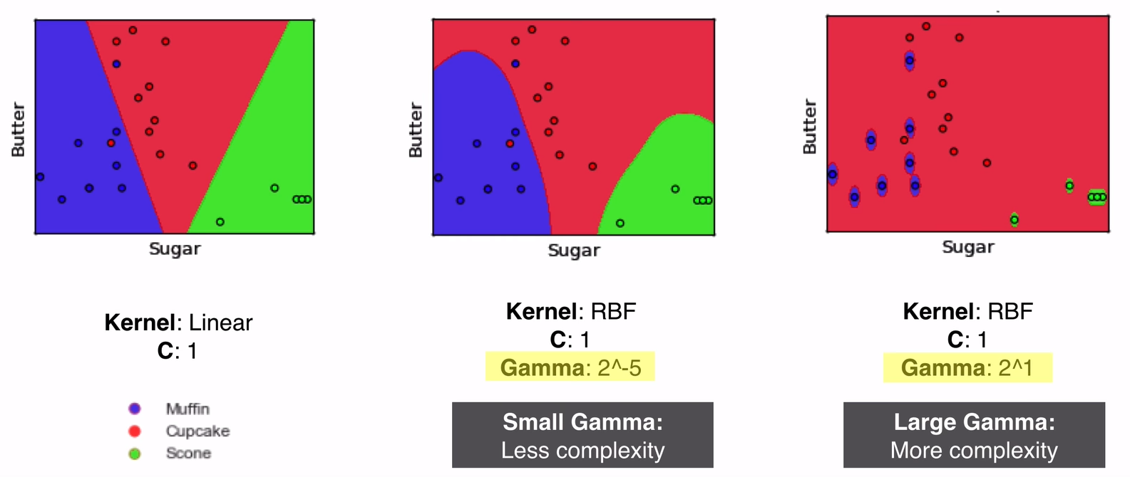
Kernel Trick: Comparison

Slide 14
Evaluation Methods
https://machinelearningcoban.com/2017/08/31/evaluation/

Slide 15
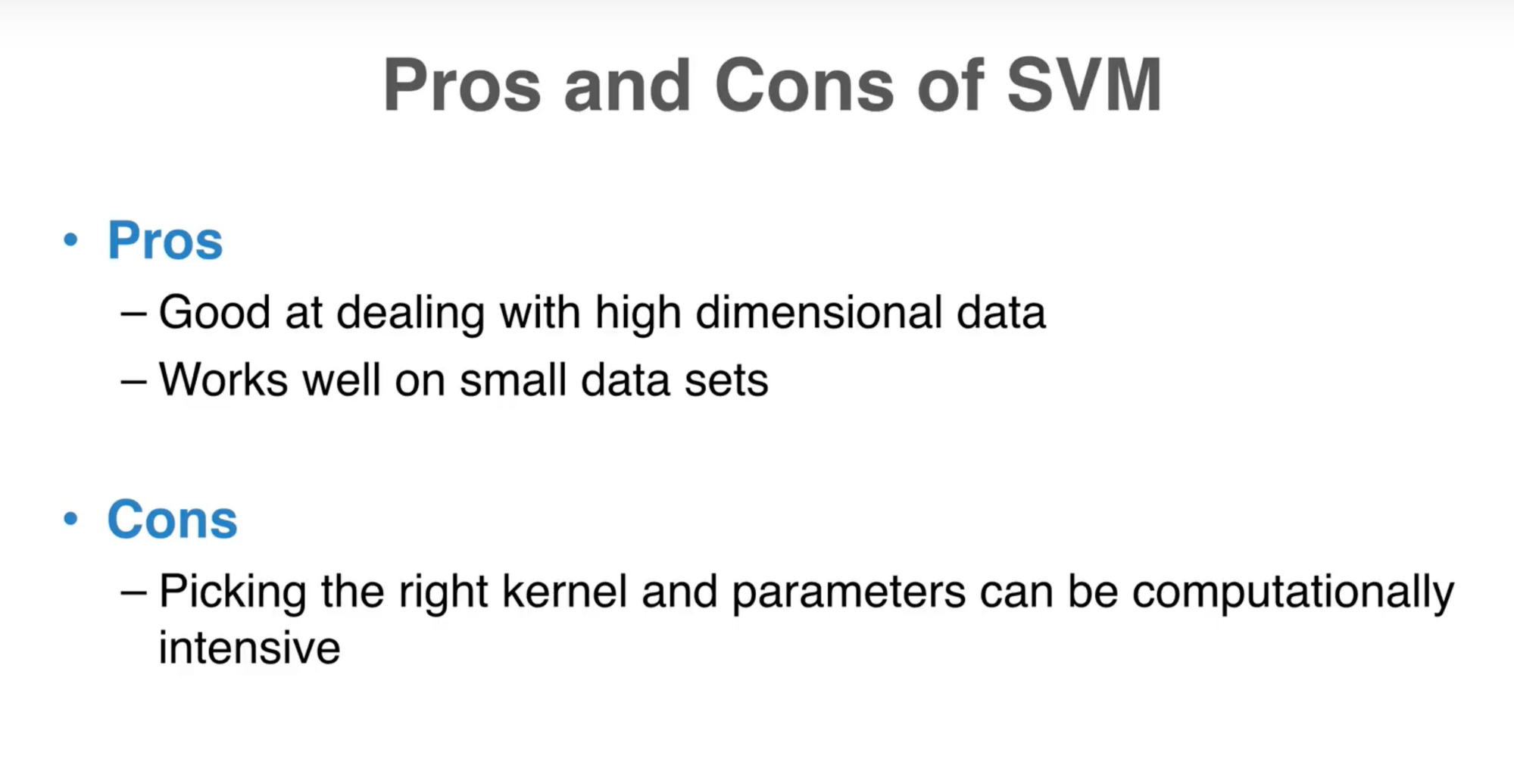
Summary

Slide 16
Demo with Python

Slide 17
References
Support Vector Machines: A Visual Explanation with Sample Python Code https://www.youtube.com/watch?v=N1vOgolbjSc
Support Vector Machine https://machinelearningcoban.com
Machine Learning A-Z
https://www.superdatascience.com/machine-learning

